Slide 1
Waste Classification Using AI
28th March 2025
GreenSkill-AI
City Engineering College
Team Members:
Amith H M
Abinaya J
Bhoomika M
Geetha S

Slide 2
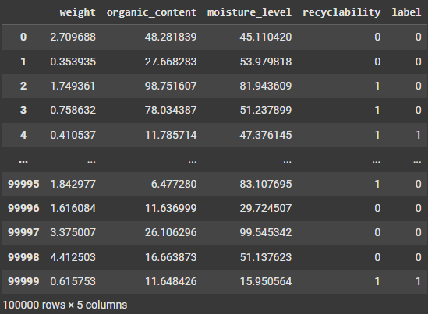
Dataset Overview
Dataset Description:
The dataset consists of 100,000 samples of waste classification data. Each sample as follows :
weight (kg): The weight of the waste item.
Organic content (%): Percentage of organic material.
Moisture level (%): Percentage of moisture present.
Recyclability (0 or 1): Indicates whether the item is recyclable.
Label (0 or 1): Target variable, where 0 represents Biodegradable waste and 1 represents Non-Biodegradable waste.

Slide 3
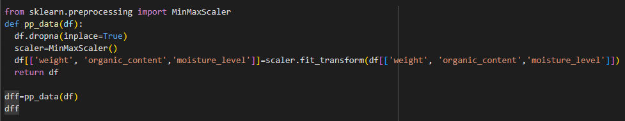
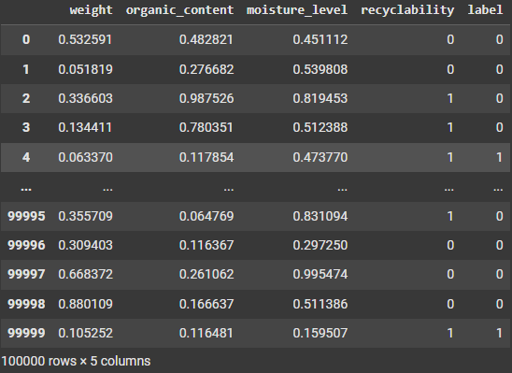
Data Pre-Processing:
Handling missing values: Any missing data points were removed.
Feature scaling: Standardization was applied to numerical features using “MinMaxScaler” class using sklearn
Train-test split: Data was divided into 80% training and 20% testing.

Slide 4
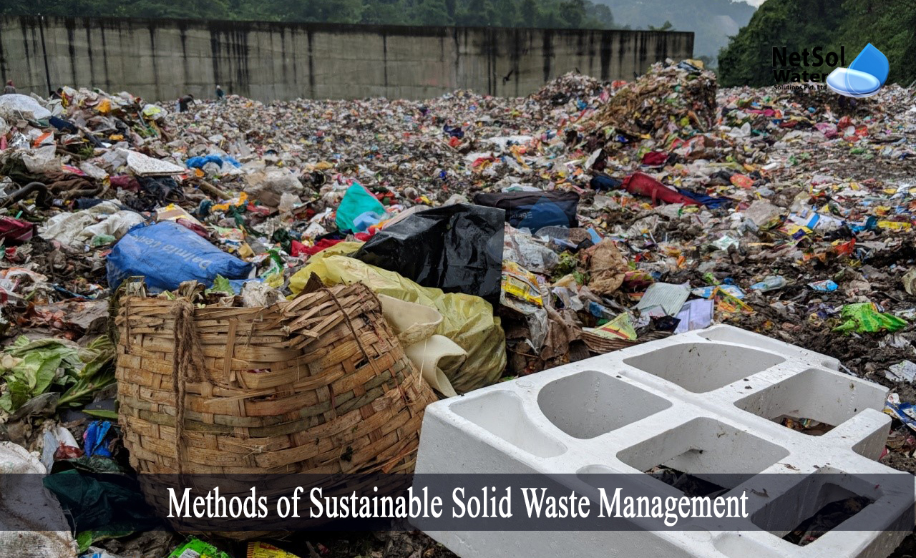
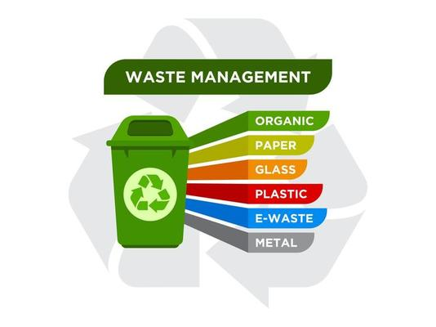
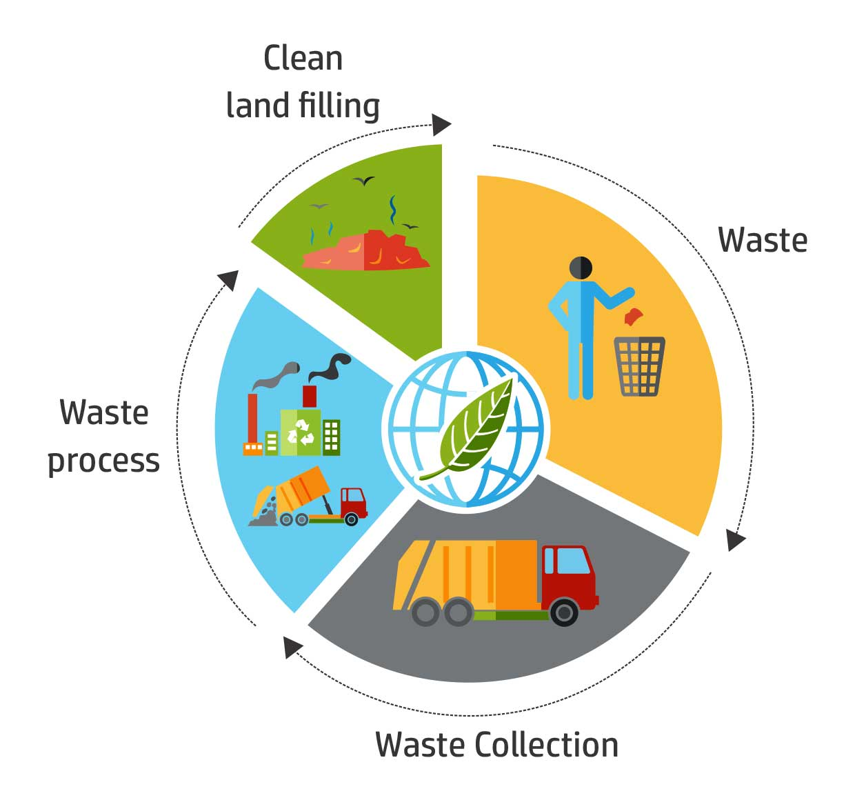
Problem Statement
Brief Overview:
This project aims to classify waste into biodegradable and non-biodegradable categories using AI. By leveraging machine learning, it provides an efficient solution to automate waste sorting, enhancing recycling processes and reducing landfill waste.
Key Objectives:
Automate waste classification using AI.
Improve efficiency in waste management.
Provide a scalable solution for environmental sustainability.

Slide 5
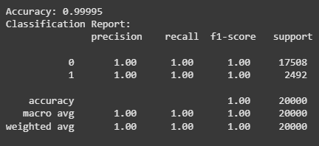
Methodology
Approach:
Data collection and preprocessing.
Utilizing a pre-trained classification model.
Model evaluation using standard performance metrics.
Visualization of results and insights.
Algorithms Used:
A pre-trained machine learning model Random Forest was used for classification.
Evaluation Metrics:

Slide 6
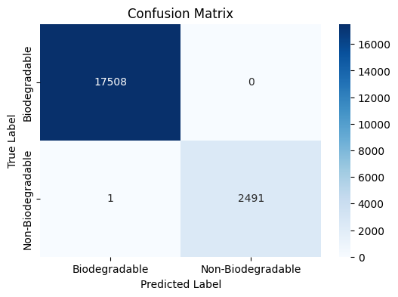
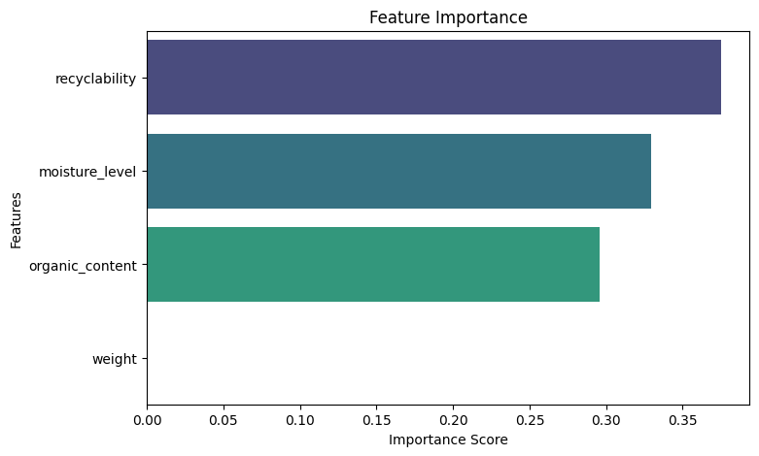
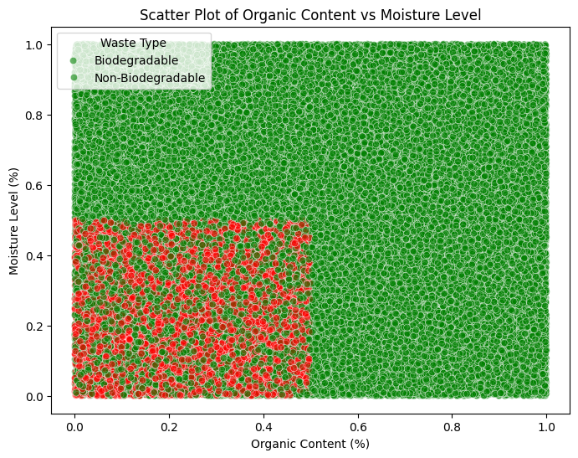
Results

Slide 7
Discussion
Insights
Organic content and moisture level significantly influence classification.
Higher recyclability does not always indicate biodegradability.
Challenges Faced
Dataset imbalance: The need to balance biodegradable and non-biodegradable waste data.
Feature selection: Identifying key features influencing predictions.
Model selection: Choosing the best algorithm for accuracy and efficiency.

Slide 8
Solution Impact
Sustainability Impact:
Enhances recycling efficiency.
Reduces landfill waste.
Supports environmental conservation efforts.
Practical Implementation:
Deploying the model in waste management plants.
Integrating AI-powered sorting machines.
Real-time monitoring and classification in smart cities.

Slide 9
Conclusion
Summary:
This project demonstrated the use of AI in classifying biodegradable and non-biodegradable waste. The model’s performance was evaluated using accuracy and classification metrics, highlighting its potential for real-world applications.
Future Work:
Incorporating image-based waste classification using deep learning.
Expanding features like material type and toxicity levels.
Developing a mobile application for real-time waste identification.

Slide 10
References
Citations:
Kaggle Datasets for reference.
Scikit-learn documentation for model implementation.
Research papers on AI-driven waste classification.
ChatGPT – to enhance the code and accuracy
Google and Bing for new libraries and Syntax

